Slide 1

Leveraging LLMs for Memory Forensics
A Comparative Analysis of Malware Detection
Key takeaway: Memory forensics with LLMs is feasible: reasoning boosts detection, false positives remain high, and the human analyst remains responsible.
Jan-Hendrik Lang & Thomas Schreck, September 16th - 17th, 2025
1/18
Notes:
Let me set expectations right away:
the goal of this project was not to replace human forensic analysts
Could LLM can become useful assistants in memory forensics.

Slide 2

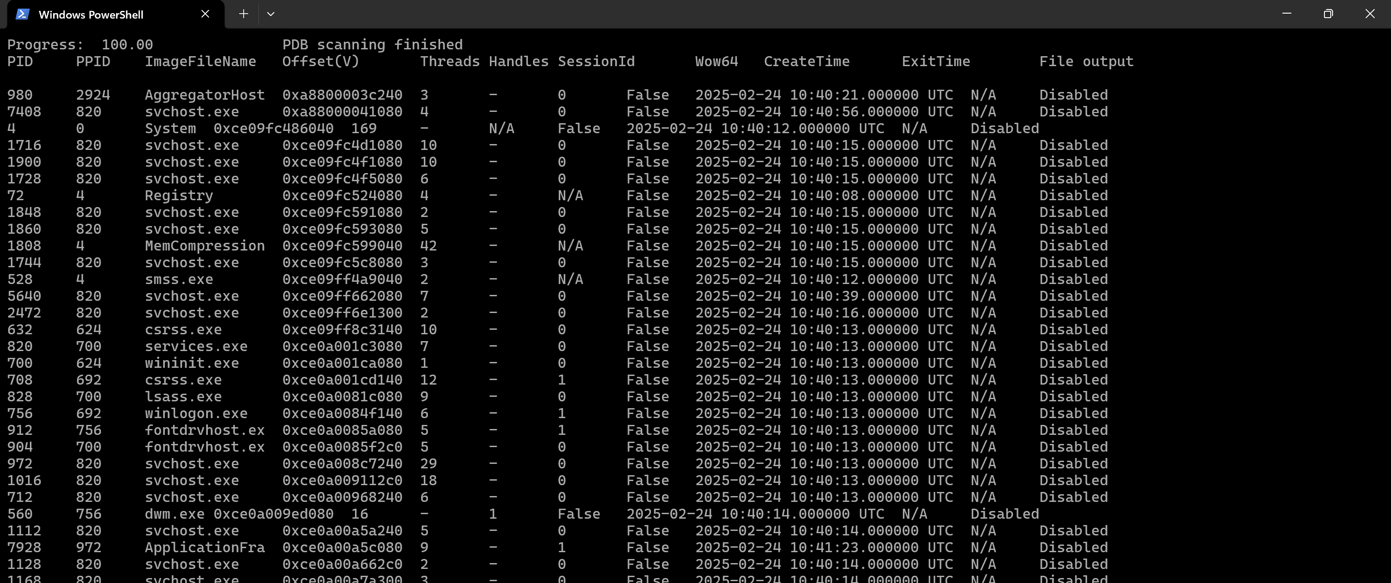
Motivation
2/18
Notes:
When I first looked at raw Volatility output, it was overwhelming.
Not alone as a junior.
Volaitlity3 is a complex tool.
In addition, knowledge of analysis and results is required.
Here we see a easy psscan output with too mutch svchosts
Where should I look, what should I do?

Slide 3
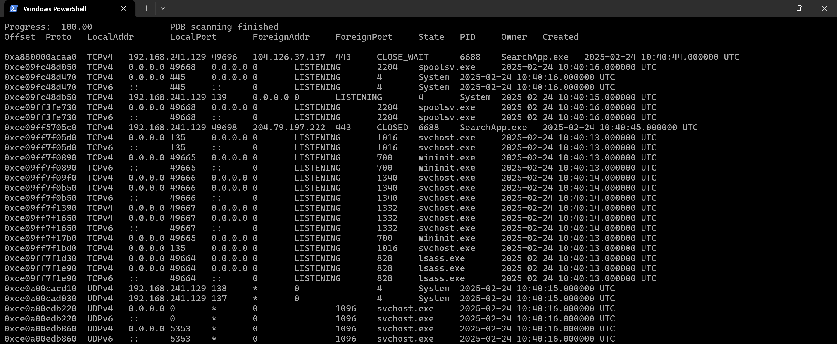
Motivation
3/18
Notes:
Deep look into netscan.
Bad arrangement. too many svchosts.
Deeper look into the memory because I´m an forensic analyst.

Slide 4
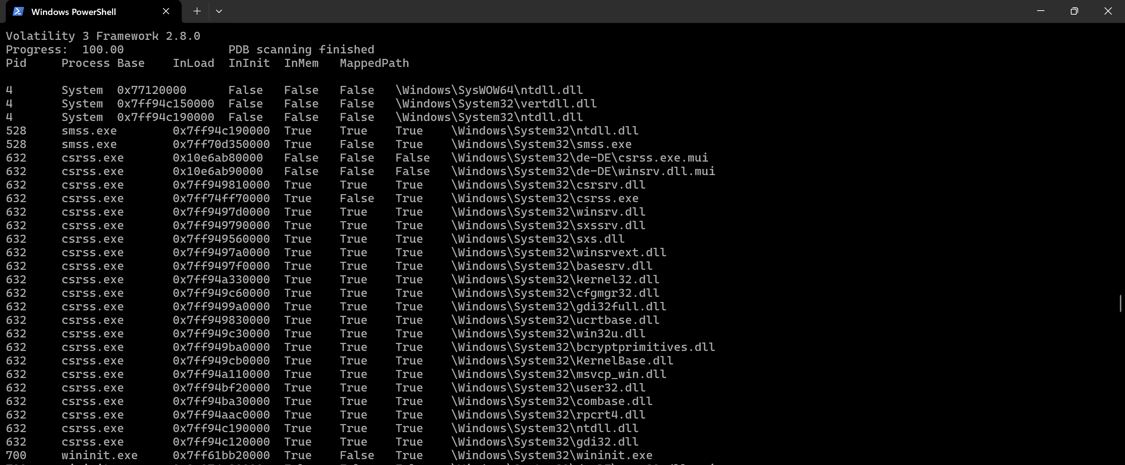
Motivation
4/18
Notes:
Here LDRMODULES. It got wore.
All I can see is a lot of Trues and False and I don’t know how to interpret them.
What if we had an assistant that could sift through this noise for us?

Slide 5
Motivation
Expertise-Intensive: requires deep specialist knowledge & manual effort
Data Overload: numerous plugin outputs, subtle IoCs to correlate
Steep Learning Curve: difficult for less-experienced analysts
Memory Forensics Importance: essential for detecting fileless malware & APTs
Analyst Fatigue: overload increases errors and slows detection
Underexplored AI Potential: unclear if LLMs can reduce effort while preserving accuracy
5/18
Notes:
This brings us to the pain points.
Expertise-Intensive: isn’t beginner-friendly. It requires deep OS knowledge and years of practice.
Data overload: a single memory dump could generate thousands of lines of output.
Steep Learning Curve: difficult for less-experienced analysts
Importance: Fileless malware, process injection. And once the system is powered off or rebooted, these traces are gone.
Fatigue and errors: even trained experts can miss subtle anomalies when scanning so much data manually.
At the same time, large language models excel at synthesizing structured information and explaining patterns.

Slide 6

Research Questions
1. Detection Performance: How do different LLMs perform in detecting malware from Volatility3 data?
2. Impact of Reasoning: Do reasoning-enabled (“thinking mode”) configurations yield statistically significant improvements in detection quality?
3. Limitations & Error Sources: What drives false positives and false negatives, and can adding baseline system knowledge reduce these errors?
6/18
Notes:
Prior research has shown that LLMs can help with cybersecurity tasks
incident reports, log analysis, intrusion detection.
There’s also exploratory work on digital forensics, but usually focused on logs, text, or disk artifacts.
What was missing is a systematic evaluation in memory forensics specifically.
Memory is special: volatile, process-centric, messy.
That’s the gap we aimed to fill.
I think these questions directly map to practical needs in incident response.

Slide 7

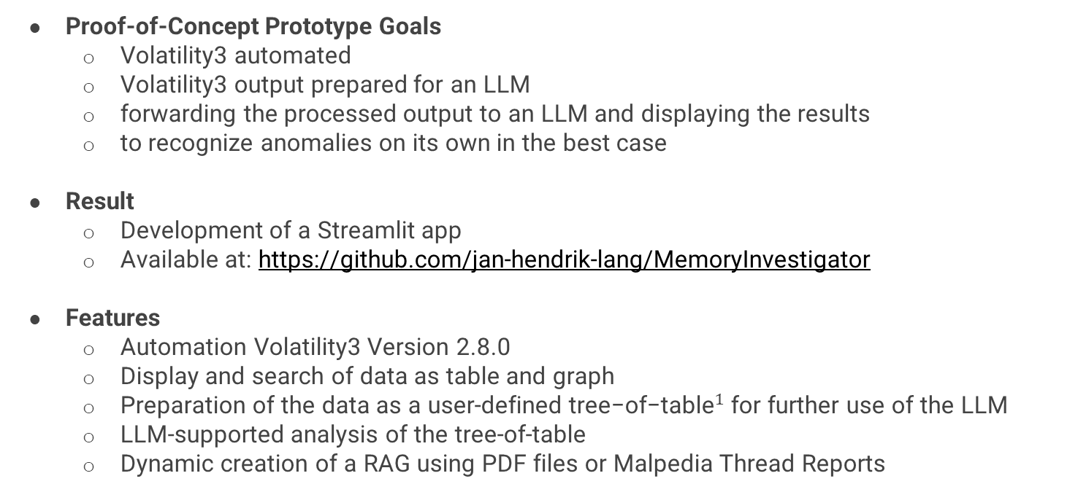
Methods: MemoryInvestigator
Proof-of-Concept Prototype Goals
Volatility3 automated
Volatility3 output prepared for an LLM
forwarding the processed output to an LLM and displaying the results
to recognize anomalies on its own in the best case
Result
Development of a Streamlit app
Available at: https://github.com/jan-hendrik-lang/MemoryInvestigator
Features
Automation Volatility3 Version 2.8.0
Display and search of data as table and graph
Preparation of the data as a user-defined ${\text{tree}\text{−}\text{of}\text{−}\text{table}}^{1}$ for further use of the LLM
LLM-supported analysis of the tree-of-table
Dynamic creation of a RAG using PDF files or Malpedia Thread Reports
[1] D. Ji et al., “Tree-of-Table: Unleashing the Power of LLMs for Enhanced Large-Scale Table Understanding,” 2024, arXiv. doi: 10.48550/ARXIV.2411.08516.
7/18

Slide 8
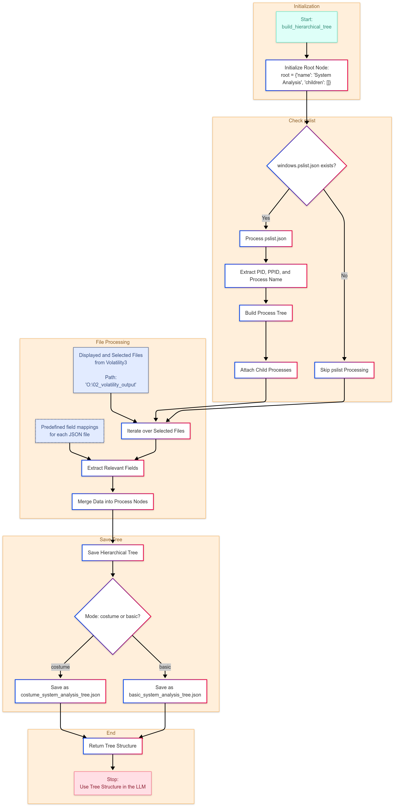
Methods: Tree-of-Table
Start
Extract from psscan
(PID, PPID, ImageFileName, CreateTime, ExitTime)
Volatility3 Modules:
Process modules like psscan, cmdline, dlllist.
Network modules like netscan.
Malware-specific plugins like malfind, processghosting, suspicious_threads.
Privilege and persistence indicators like getsids and svcdiff.
Build Tree
PID: node PPID: parent-child relationship
File Enrichment
cmdline, dlllist, handles, …
data from pre-selected fields
End
8/18
Notes:
Tree-of-Table Method to give the LLM not prosa text.
Extract Data from psscan
Build tree-of-table
Enriche with data
Selecting Volatility3 Moduls
a) broad forensic coverage across process activity, network behavior, injected code, and persistence artifacts.
b) every additional plugin increases noise, token size, and the chance of overwhelming the LLM.
Oriented on the SANS Memory Forensics Process
Fundamentel Core process context: psscan, cmdline, dlllist
provide the baseline view of what’s running,
how it was launched
DLLs it depends on.
Malware indicators: plugins like malfind, hollowprocesses, and processghosting directly target common malware injection and stealth techniques.
Environment & persistence: getsids and svcdiff reveal unusual privileges or service modifications, which are classic persistence vectors.
Network visibility: netscan and netstat show live connections—critical for spotting C2 traffic.
So instead of overwhelming the model
we used a balanced set t

Slide 9
Methods: Tree-of-Table
Processes
├─ System (pid=4, ppid=0)
├── SID: S-1-5-18, S-1-5-32-544, ...
├── ldrmodules: ntdll.dll [InInit=False, InLoad=False, InMem=False]
├── netscan: UDPv4, 192.168.10.210:137 → LISTENING
├── Registry (pid=92)
├─── SID: S-1-5-18, S-1-5-32-544, ...
├─── ldrmodules: ntdll.dll [InInit=False, InLoad=False, InMem=False]
├─── netscan: UDPv4, 192.168.10.210:137 → LISTENING
└── smss.exe (pid=328)
{
"name": "System Analysis",
"children": [
{
"name": "Processes",
"children": [
{
"name": "System",
"pid": 4,
"ppid": 0,
"SID": [
"S-1-5-18",
"S-1-5-32-544",
"S-1-1-0",
"S-1-5-11"
],
"ldrmodules": {
"InInit": false,
"InLoad": false,
"InMem": false,
"MappedPath": "\\Windows\\System32\\ntdll.dll"
},
"netscan": {
"Created": "2023-06-02T17:45:43+00:00",
"Owner": "System",
"Proto": "UDPv4",
"LocalAddr": "192.168.10.210",
"LocalPort": 137,
"ForeignAddr": "*",
"ForeignPort": 0,
"State": "LISTENING"
},
{
"name": "System Analysis",
"children": [
{
"name": "Processes",
"children": [
{
"name": "System",
"pid": 4,
"ppid": 0,
"SID": [
"S-1-5-18",
"S-1-5-32-544",
"S-1-1-0",
"S-1-5-11"
],
"ldrmodules": {
"InInit": false,
"InLoad": false,
"InMem": false,
"MappedPath": "\\Windows\\System32\\ntdll.dll"
},
"netscan": {
"Created": "2023-06-02T17:45:43+00:00",
"Owner": "System",
"Proto": "UDPv4",
"LocalAddr": "192.168.10.210",
"LocalPort": 137,
"ForeignAddr": "*",
"ForeignPort": 0,
"State": "LISTENING"
},
"netstat": {
"Created": "2023-06-02T17:45:43+00:00",
"Owner": "System",
"Proto": "UDPv4",
"LocalAddr": "192.168.10.210",
"LocalPort": 138,
"ForeignAddr": "*",
"ForeignPort": 0,
"State": "LISTENING"
}
}
]
}
]
}
9/18
Notes:
Here’s an example of the structured JSON we feed to the model.
At the top level, you have processes, and under each process you can see DLLs, command-line arguments, network sockets, and suspicious artifacts.
Instead of handing the LLM hundreds of separate tables
provide one coherent snapshot of the system
cleaner, compact, and logically organized.

Slide 10

Evaluation and Results
System Message:
You are a forensic RAM analyst assistant specializing in Windows memory analysis. Analyze the JSON tree of Windows memory artifacts to detect intrusions or malicious activities. Cross-check your findings with known threats and provide clear, specific reasons for flagging any anomalies (e.g., unusual parentchild relationships, code injection, execution from nonstandard locations). If you are unsure, ask clarifying questions, and if you don’t know, say so. Generate a structured forensic report highlighting confirmed threats while minimizing noise. Data: “Tree-of-Table Data”
User Message: Analyze the data and determine whether there is an anomaly.
10/18
Notes:
We didn’t just dump data into a model and say “find malware.” The design of the prompt is critical.
The prompt framed the model as if it were a forensic RAM analyst. It was given:
A role description: “You are an expert memory forensic investigator.”
A structured dataset in the Tree-of-Table format.
A specific task: “Identify suspicious processes, explain your reasoning, and output your findings in a structured list.”
This had several benefits:
By assigning the role, we anchor the model into the mindset of structured investigation.
By giving structured JSON, we prevent it from free-associating text and force it to reason on concrete evidence.
By requiring explanations, we can evaluate why it flagged a process, not just what. That’s how we could later identify error sources—for example, when the model misinterpreted benign malfind results.

Slide 11
Evaluation and Results
Test Scenarios:
Clean Image,
Process Injection (msfvenom),
PowerShell Empire,
QuasarRAT (Remote Access Trojan),
MassLogger (keylogger),
DarkCloud (trojan),
LockBit (ransomware),
LokiBot (stealer).
LLMs for Comparison:
OpenAI GPT-4o,
OpenAI o1,
Google Gemini 2.0 Flash,
Google Gemini 2.0 Flash-Thinking,
Grok 3,
Grok 3 with enabled thinking mode.
11/18
Notes:
Test Scenarios: broad spectrum of attack techniques and real-world relevance:
Clean Image to test halizunations.
Metasploit msfvenom payloads → Simple process injection.
PowerShell Empire → Fileless, script-based malware. Encoded in base64.
Commercial Malware from Malwarebazzar.
This diversity was crucial because an LLM might excel at decoding suspicious command-lines but fail at spotting injected threads — so we needed multiple families to stress-test different detection pathways.
LLMs
Availability & reproducibility: results that other researchers can replicate.
Different architectures & vendorswe avoid bias toward a single ecosystem.
Reasoning vs. non-reasoning modes: measure the impact of explicit reasoning on detection.
about comparing across vendors and modes to see where strengths and weaknesses lie.
No Local LLM:
Benchmark strength: At the time of testing, commercial models like GPT-4o and Gemini were significantly ahead in reasoning quality compared to locally runnable models
Consistency & reproducibility: Hosted APIs provide stable versions that other researchers can call with the same parameters.
Practical constraints: Running high-parameter local models requires substantial GPU resources
local models are very promising for future work

Slide 12
Evaluation and Results
Select Malware
Execute Malware
Take Memory Image
Analyse with LLMs (240 trails)
Build Test Enviroment
Performance Metrics:
Accuracy,
Precision,
Recall,
F1-score,
ANOVA,
t-tests.
12/18
Notes:
Test Enviroment
Virtualization setup: VMware Workstation 17, Windows 10 Version 22H2 (4GB RAM, 1 vCPUs).
Network settings: Windows 10 VM -> Kali Linux VM via VMware Workstation internal network.
Simulated user activity: Firefox, Foxit PDF Reader, LibreOffice, TeamViewer, WinRAR, ProcMon
Memory capture tool: BelkaSoft’s RamCapture64.exe.
Evaluate at the process level: FP, FN, TP, TN
Metrics:
Accuracy:
Precision:
Recall:
F1 score: harmonic mean of precision and recall, balancing both.
ANOVA and t-tests to compare models and test whether reasoning modes improved results significantly.

Slide 13
Evaluation and Results
Experiment scale: 240 trials (8 scenarios × 1 image × 6 LLMs × 5 runs)
Detection: All LLMs found malicious evidence in most scenarios
Reasoning helps: “Thinking” modes consistently outperformed standard modes
Different strengths: Models excel at different artifact types (e.g., network vs. script decoding)
Performance pattern: Very high recall (often ≈100%) — low precision (precision often <20%)
Blind spot: LockBit IoCs were outside available inputs → missed detections
Common FP source: malfind outputs (e.g., MsMpEng.exe) frequently mis-flagged
13/18
Notes:
Across 240 trials, here’s the picture:
All models successfully found malicious evidence in most scenarios.
Reasoning modes consistently helped—the “thinking” versions outperformed their non-thinking counterparts.
Models showed different strengths:
OpenAI o1 and Gemini-Thinking decoded PowerShell Empire’s Base64 payloads.
Grok 3 excelled at network anomalies.
But the most important pattern:
Recall was excellent—often near 100%.
Precision was very low—often below 20%. In other words: they caught nearly everything malicious, but they flagged a lot of benign processes too.
LockBit blind spot: relevant indicators weren’t present in the selected plugin data.
FP malfind plugin: overinterpret Windows Defender.

Slide 14
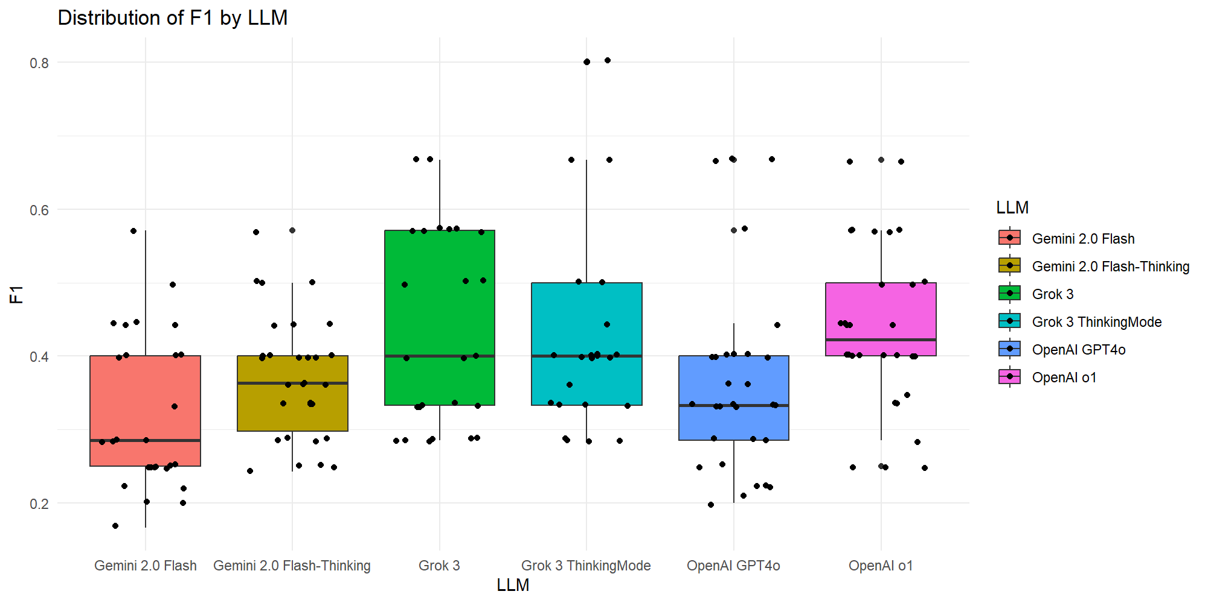
Evaluation and Results
Distribution of F1-score by LLM
14/18
Notes:
F1 score: balances precision and recall.“
recall was near perfect for most models
the low precision dragged the F1 down – meaning the models constantly raised false alarms.“
„Reasoning-enabled models (OpenAI o1 or Grok 3 (Thinking Mode)) scored highest.
LLM must be used under human supervision
Box (rectangle): covers the interquartile range (IQR) — the middle 50% of the data.
Bottom edge = Q1 (25th percentile)
Top edge = Q3 (75th percentile)
Line inside box: the median (50th percentile).
Whiskers (vertical lines): extend to the lowest and highest values within 1.5 × IQR from the box.
Dots outside whiskers: outliers — unusually high or low values.

Slide 15

Limitations
Dataset Scope: one memory image per scenario; limited to Windows 10
Data Coverage: only selected Volatility3 plugins; no registry hives, EVTX logs, or raw strings
Model Dependence: results bound to specific LLM versions & modes (non-deterministic behavior)
Precision Gap: high false positive rate; not suitable as a standalone detection system
Generalizability: performance on other OS, larger datasets, or different attack techniques remains untested
15/18

Slide 16
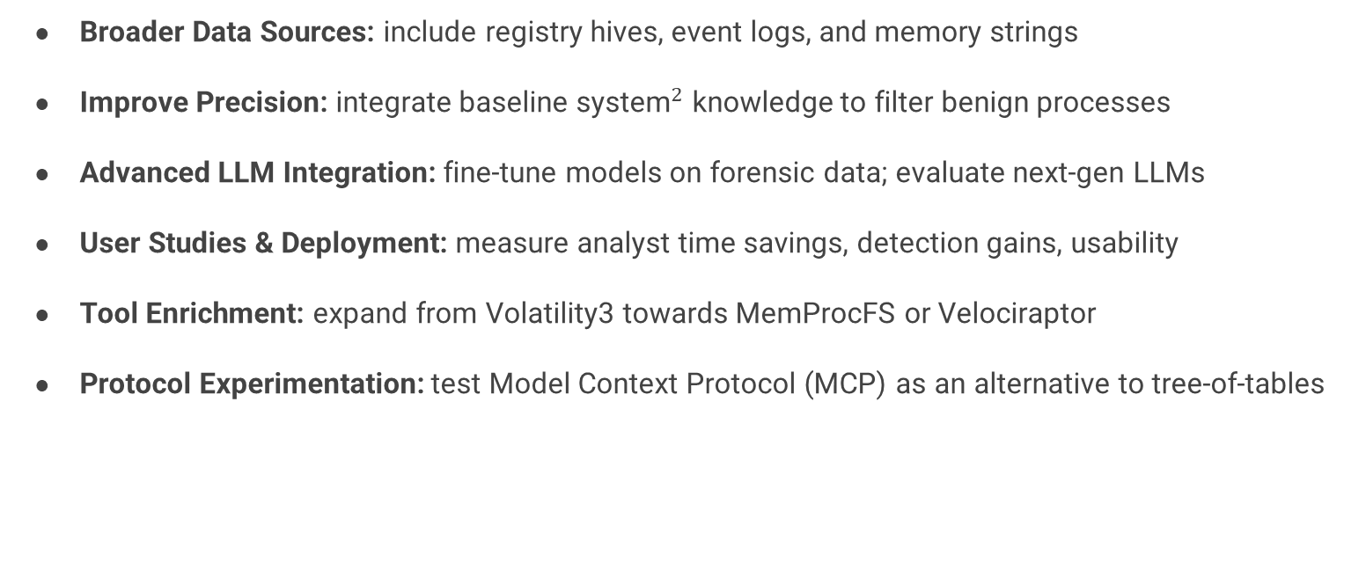
Future Work
Broader Data Sources: include registry hives, event logs, and memory strings
Improve Precision: integrate ${\text{baseline} \text{system}}^{2}$ knowledge to filter benign processes
Advanced LLM Integration: fine-tune models on forensic data; evaluate next-gen LLMs
User Studies & Deployment: measure analyst time savings, detection gains, usability
Tool Enrichment: expand from Volatility3 towards MemProcFS or Velociraptor
Protocol Experimentation: test Model Context Protocol (MCP) as an alternative to tree-of-tables
[2] Gordon Fraser. 2021. Creating a Baseline of Process Activity for Memory Forensics.
16/18

Slide 17

Conclusion
Feasibility & Value: LLMs can sift memory data and highlight likely IoCs
Recall vs. Precision: strong recall, but very low precision (many false alarms)
Context Matters: success depends on the breadth of forensic input data
Human Essential: analysts remain critical due to false positives & blind spots
LLMs as Support: assist in triage, improve interpretability, not a replacement
17/18
Notes:
LLMs can highlight leads,
explain anomalies,
help less experienced analysts
but they must always be paired with human validation.
Think of it as extra pair of eyes—fast, but not always reliable.

Slide 18

AI be like:
Contact Details
Jan-Hendrik Lang
jan-hendriklang@hotmail.de
Thomas Schreck
thomas.schreck@hm.edu
GitHub Repo:
https://github.com/
jan-hendrik-lang/
MemoryInvestigator
everything is malware
18/18

